Slide 1
INVENTRA
IntelligentInventory ManagementSystem
Domain: Electronic Gadgets Shop (Laptops, Computers, Accessories)
Infosys Springboard | Virtual Internship 6.0 | Team 2
Christina J Krishna Moorthy Anbalagan Rajeswari R Shirisha Singha Ganji Sudharsan Balaji

Slide 2





CRITICALITY OF MANAGEMENT
High-Value Items
Electronic gadgets are expensive assets that require precise tracking to prevent capital leakage.
Fast-Moving Goods
Accessories like chargers and SSDs move rapidly; depletion leads to immediate revenue loss.
Financial Integrity
Incorrect stock level detection directly causes financial discrepancies and budget misalignment.
Peak Hour Efficiency
Manualtrackingmethods consistently fail during
high-traffic hours, causing customer dissatisfaction.

Slide 3
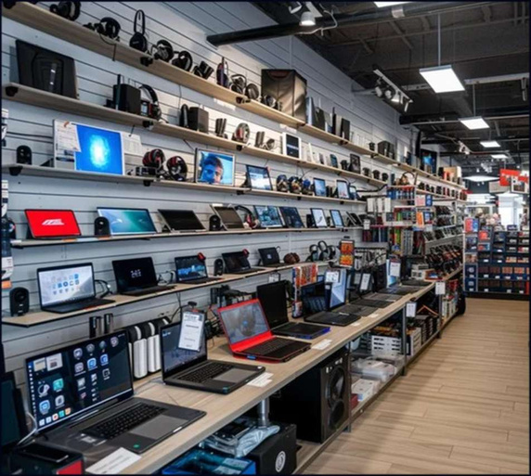


SHOP INVENTORY ENVIRONMENT
Core Products:Laptops, Keyboards, Mouse, Chargers, SSDs
Operational Flow:Multiple staff members
handling inventory daily
Precision:Real-time stock accuracy is non-
negotiable
Compliance:Accountability is essential for all
updates

Slide 4

IDENTIFIED CHALLENGES
Duplicate Entries:
Redundant gadget records causing data clutter.
Post-Sale Errors:
Mismatch in stock levels immediately after transactions.
Zero Traceability:
Nohistorical record of which staff member updated specific items.
Late Detection: Weak Access Control:
Low-stock alerts for accessories are delayed or missed.
Vulnerable security protocols for inventory modification.

Slide 5
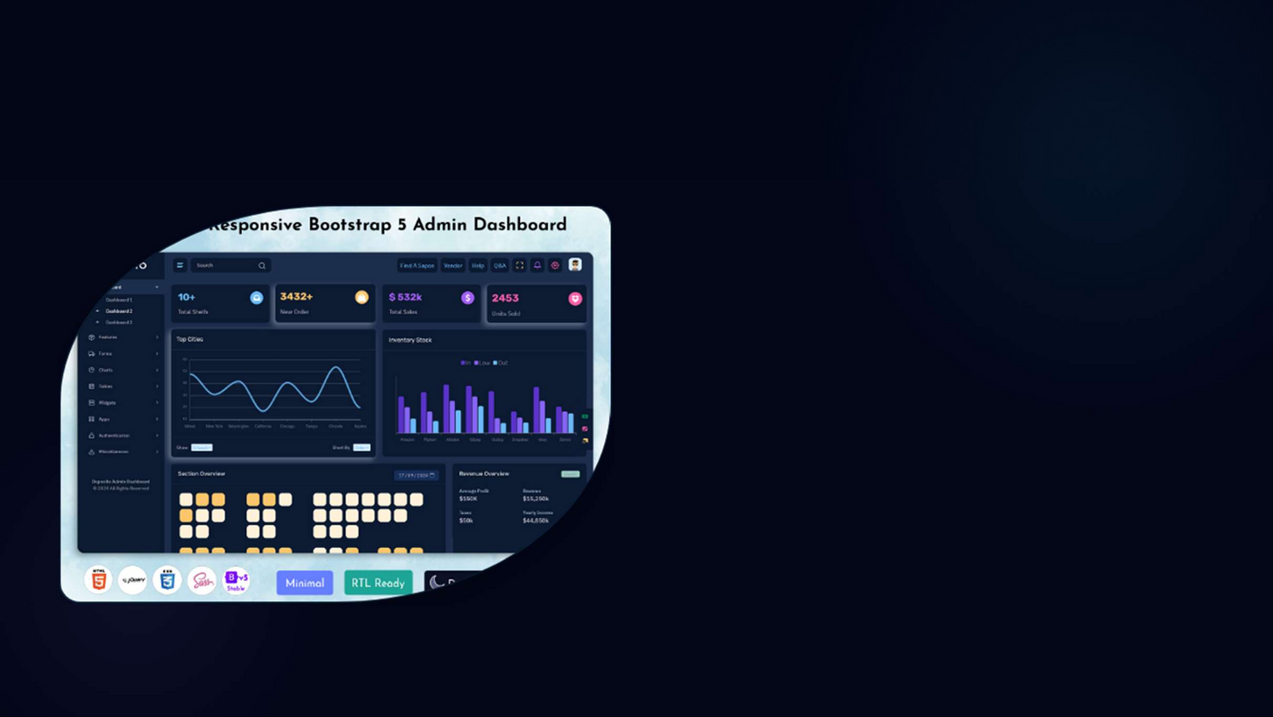
THE INVENTRA SOLUTION
Centralized System:One single source of truth for all branches.
RBAC:Secure role-based login for admin and
staff.
Live Updates:Instantaneous stock adjustments. Automated Alerts:Proactive notification for
low-stock items.
Audit Trail:Complete transaction tracking for
accountability.
Dashboard shown is a conceptual representation of the planned system UI

Slide 6







TECHNOLOGICAL FOUNDATION
Frontend
Backend
Middleware
REST API architecture for seamless communication between components.
HTML5, CSS3, JavaScript for a responsive and intuitive interface.
Java with Spring Boot framework for robust business logic processing.
Security
Storage
Development
IntelliJ IDEA as the primary Integrated Development Environment.
JWT (JSON Web Tokens), BCrypt password hashing, and RBAC.
MySQL relational database for structured and reliable data persistence.

Slide 7

SYSTEM ARCHITECTURE
Request Flow
Controller Layer
Intercepts user requests and routes them to appropriate service handlers.
Controller → Service → Repository →
Database
Service Layer
Encapsulates core business logic, validation rules, and transaction boundaries.
Repository Layer
Manages database interactions and data mapping via JPA/Hibernate.

Slide 8






CORE MODULES
Authentication
Security and identity management.
Inventory
Stock management and cataloging.
Monitoring
Real-time alerts and stock levels.
Transactions
IN/OUT operation tracking.
Reports & Analytics
Data-driven decision support and historical trends.

Slide 9


AUTHENTICATION
Secure login for Admin and Staff. Role-Based Access Control (RBAC). Industry-standard BCrypt encryption. Zero tolerance for unauthorized access.

Slide 10

Authentication –Business Impact
Admin Privileges
Full control over high-value laptop catalogs and store-wide settings.
Staff Operations
Restricted access to daily stock updates for accessories and sales entry.
Unique Identities
Strict "no-shared-accounts" policy ensures complete individual accountability.
Dispute Resolution
Clear audit logs allow management to resolve stock discrepancies instantly.

Slide 11

INVENTORY MANAGEMENT OPERATIONS
Product Ingestion: Dynamic Adjustment:
Seamlessly add new electronic products with detailed specs.
Automatic stock updates after every single sale or purchase.
Quantity Tracking: Validation:
Real-time visibility of available shelf and warehouse stock.
Intelligentchecks to prevent duplicate product entries and data corruption.

Slide 12

OPERATIONAL WORKFLOW
Stock IN
Stock OUT
Sync
Record
New Dell Laptops arrive;
Wireless Mouse sold; quantity decremented.
Database updated instantly across
Transaction history
system logs entry.
logged for audit trail.
mo dules.

Slide 13

ALERTS & MONITORING
Automated Thresholds
Continuous monitoring of accessory stock levels against minimum safety margins.
Zero Revenue Loss
Instant alert generation prevents "Out of Stock" scenarios during peak demand.
Stock Vigilance

Slide 14


CASE STUDY: LOW-STOCK MITIGATION
Scenario: Charger stock drops below 10 units.
System detects breach of threshold.
Alert generated for Admin dashboard.
Admin restocks before shortage impacts
customers.
Representative product image for demonstration

Slide 15

TRANSACTION MANAGEMENT
Timestamp
Product
User
Type
Quant ity
2026-02-02 10:15
Dell XPS 15
Admin
STOCK_IN
+15
2026-02-02 11:30
Logitech Mouse
Staff_1
STOCK_OUT
-05
2026-02-02 14:45
Samsung SSD 1TB
Staff_2
STOCK_OUT
-02
2026-02-02 16:00
Laptop Charger
Admin
STOCK_IN
+50

Slide 16
WHY TRANSACTION LOGS MATTER ?
Transparency isn't just a feature; it's the foundation of trust. By identifying exactly who updated the laptop stock and when, we eliminate disputes and maintain a trusted operational record.

Slide 17


REPORT & ANALYTICS
Inventory Summaries:
Periodic snapshots of
total asset value.
Historical Trends:
Track stock movement over
weeks or months.
75%
Granular Analysis:
metrics.
Product-wise performance
Efficiency
Gain
Strategic Support:
procurement.
Data-driven insights for

Slide 18
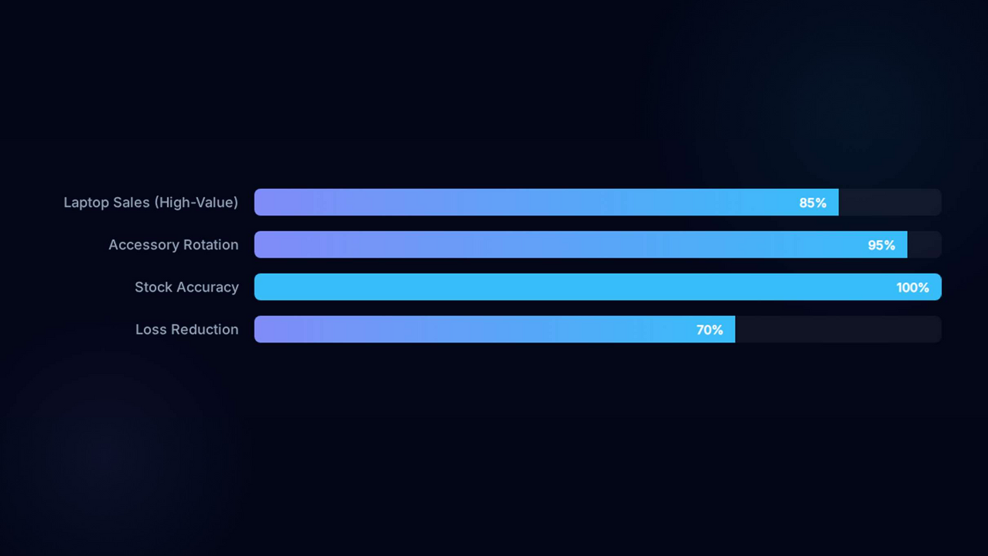
ACTIONABLE INSIGHTS
INVENTRA allows management to identify fast-selling accessories and plan laptop restocking with mathematical precision.

Slide 19






THE INVENTRA ADVANTAGE
Accuracy
Elimination of human error in stock counting.
Security
Multi-layered RBAC and data encryption.
Automation
Intelligent alerts and real-time syncing.
Audit Trail
100% traceability for every transaction.
Loss Prevention
Significant reduction in manual errors and shrinkage.

Slide 20



DOMAIN BENEFITS
Better control of high-value electronic gadgets and fragile inventory.
Avoid frequent accessory stock-outs during
major tech releases.
Faster decision-making for inventory
procurement and pricing.
Dramatically improved operational efficiency for
retail staff.

Slide 21
Conclusion
INVENTRA is a purpose-built solution for the modern electronic gadget ecosystem. By ensuring accuracy, security, and transparency, it not only reduces operational losses but also provides a scalable foundation for future business expansion.

Slide 22

Thank You
Any Questions?
Project Developed by Team 2
Infosys Springboard Virtual Internship 6.0

